Slide 1
Management Stephen P. Robbins | Mary Coulter
Chapter 2 Making Decisions

Slide 2
Learning Objectives
Describe the eight steps in the decision-making process.
Develop your skill at being creative.
Explain the four ways managers make decisions.
Classify decisions and decision-making conditions.
Describe different decision-making styles and discuss how biases affect decision making.
Know how to recognize when you’re using decision-making errors and biases and what to do about it.
Identify effective decision-making techniques.
© Pearson Education Limited 2016

Slide 3
The Decision-Making Process
Decision - A choice among two or more alternatives.
Decisions (choices, judgments) play an important role in what an organization has to do or is able to do
Managers at all levels and in all areas of organizations make decisions. That is, they make choices
© Pearson Education Limited 2016

Slide 4

The Decision-Making Process
Step 1: Identify a Problem:
Problem – An obstacle that makes it difficult to achieve a desired goal or purpose. Every decision starts with a problem, a discrepancy between an existing and a desired condition.
Example – Amanda is a sales manager whose reps need new laptops
© Pearson Education Limited 2016

Slide 5

The Decision-Making Process
Step 2: Identify Decision Criteria
Decision criteria are factors that are important (relevant) to resolving the problem.
Example – Amanda decides that memory and storage capabilities, display quality, battery life, warranty, and carrying weight are the relevant criteria in her decision
© Pearson Education Limited 2016

Slide 6
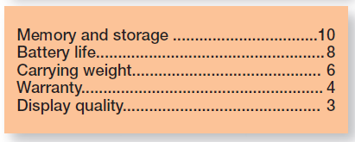
The Decision-Making Process
Step 3: Allocate Weights to the Criteria
If the relevant criteria aren’t equally important, the decision maker must weight the items in order to give them the correct priority in the decision.
Example – Amanda allocates following weights to each criteria out of 10
© Pearson Education Limited 2016

Slide 7
The Decision-Making Process
Step 4: Develop Alternatives
List viable alternatives that could resolve the problem.
Example – Amanda, identifies eight laptops as possible choices
© Pearson Education Limited 2016

Slide 8
The Decision-Making Process
Step 5: Analyze Alternatives
A decision maker must evaluate each one. Appraising each alternative’s strengths and weaknesses. An alternative’s appraisal is based on its ability to resolve the issues related to the criteria and criteria weight.
Example – By using the criteria established in Step 2. Exhibit 2-3 shows the assessed values that Amanda gave each alternative after doing some research on them
© Pearson Education Limited 2016

Slide 9
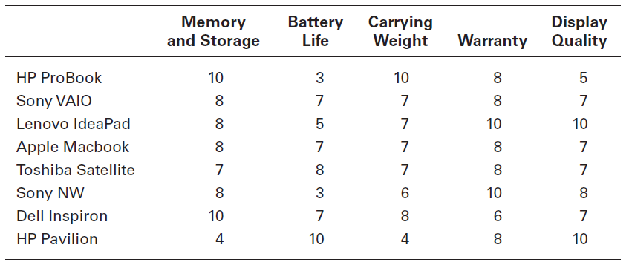
Exhibit 2-3: Possible Alternatives
© Pearson Education Limited 2016

Slide 10
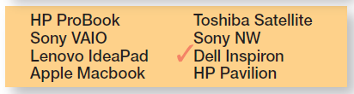
The Decision-Making Process
Step 6: Select an Alternative
Choosing the best alternative. The alternative with the highest total weight is chosen.
Example - Amanda would choose the Dell Inspiron because it scored higher than all other alternatives (249 total)
© Pearson Education Limited 2016

Slide 11
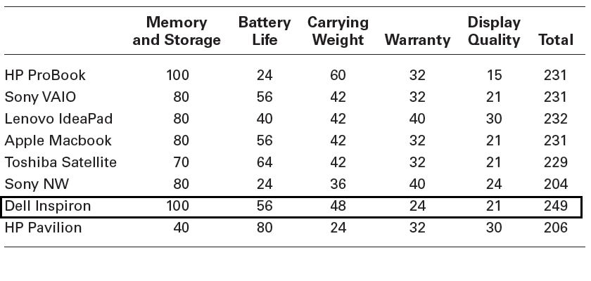
Exhibit 2-4: Evaluation of Alternatives
© Pearson Education Limited 2016

Slide 12

The Decision-Making Process
Step 7: Implement the Alternative
Putting the chosen alternative into action. Conveying the decision to and gaining commitment from those who will carry out the alternative.
Example - Amanda tells her sales representatives that Amanda chose Dell Inspiron and would buy it
© Pearson Education Limited 2016

Slide 13
The Decision-Making Process
Step 8: Evaluate Decision Effectiveness
The soundness of the decision is judged by its outcomes.
How effectively was the problem resolved by outcomes resulting from the chosen alternatives?
If the problem was not resolved, what went wrong?
© Pearson Education Limited 2016

Slide 14
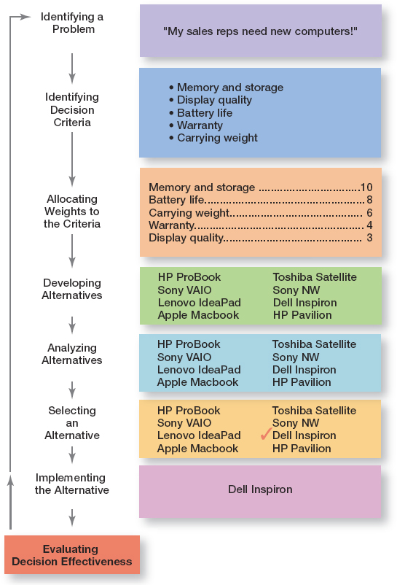
Exhibit 2-1: Decision-Making Process
© Pearson Education Limited 2016

Slide 15
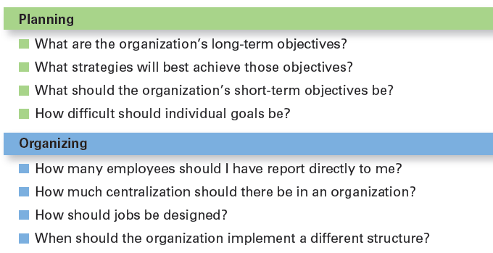
Exhibit 2-5: Decisions Managers May Make
© Pearson Education Limited 2016

Slide 16
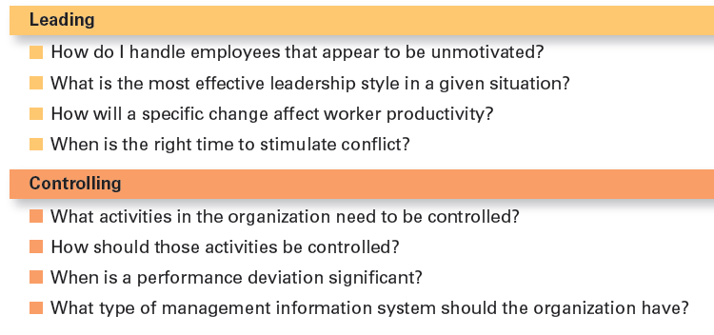
Exhibit 2-5: Decisions Managers May Make
© Pearson Education Limited 2016

Slide 17
Four Perspectives
How Managers make decisions?
© Pearson Education Limited 2016

Slide 18
Making Decisions: Rationality
Rational Decision Making - Describes choices that are logical and consistent and maximize value.
Assumptions of Rationality
A rational decision maker would be fully objective and logical
The problem faced would be clear and unambiguous
The decision maker would have a clear and specific goal and know all possible alternatives and consequences
Making decisions rationally would consistently lead to selecting the alternative that maximizes the likelihood of achieving that goal
Decisions are made in the best interests of the organization
© Pearson Education Limited 2016

Slide 19
Making Decisions: Bounded Rationality
Bounded Rationality – Decision making that’s rational, but limited (bounded) by an individual’s ability to process information.
Satisfice - Accept solutions that are “good enough”.
Escalation Of Commitment – An increased commitment to a previous decision despite evidence it may have been wrong.
© Pearson Education Limited 2016

Slide 20

Making Decisions: The Role of Intuition
Intuitive Decision Making – Making decisions on the basis of experience, feelings, and accumulated judgment.
© Pearson Education Limited 2016

Slide 21
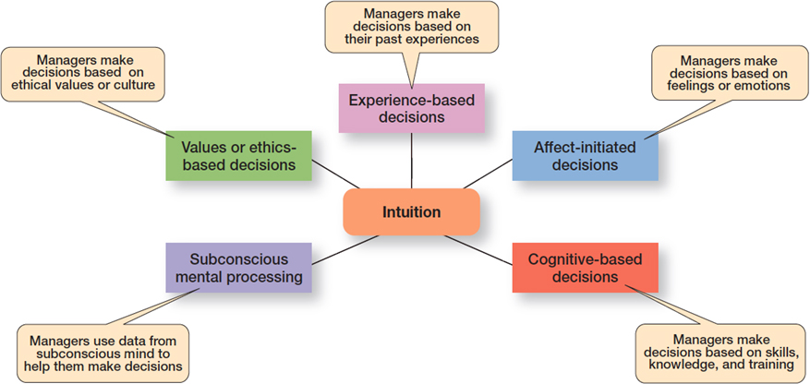
Exhibit 2-6: What Is Intuition?
© Pearson Education Limited 2016

Slide 22
Making Decisions: The Role of Evidence-Based Management
Evidence-based Management (EBMgt) – The systematic use of the best available evidence to improve management practice.
The four essential elements of EBMgt are:
The decision maker’s expertise and judgment.
External evidence that’s been evaluated by the decision maker.
Opinions, preferences, and values of those who have a stake in the decision.
Relevant organizational (internal) factors such as context, circumstances, and organizational members.
© Pearson Education Limited 2016

Slide 23
Types of Decisions & Decision-Making Conditions
Types of Decisions
© Pearson Education Limited 2016

Slide 24
Structured Problems and Programmed Decisions
Structured Problems – Straightforward, familiar, and easily defined problems.
Programmed Decision - A repetitive decision that can be handled by a routine approach.
Example:
Customer returns a purchase to a store
Late delivery
Withdrawal from a course
© Pearson Education Limited 2016

Slide 25
Structured Problems and Programmed Decisions
Procedure – A series of sequential steps used to respond to a well-structured problem.
Rule – An explicit statement that tells managers what can or cannot be done.
Policy – A guideline for making decisions.
© Pearson Education Limited 2016

Slide 26
Unstructured Problems and Non-programmed Decisions
Unstructured Problems - Problems that are new or unusual and for which information is ambiguous or incomplete.
Non-programmed decisions - Unique and nonrecurring decisions that require a custom-made solution.
Example:
Building a new manufacturing facility
Modification of business process to comply with the new law
© Pearson Education Limited 2016

Slide 27
Exhibit 2-7: Programmed Versus Non-programmed Decisions
Characteristic | Programmed Decisions | Nonprogrammed Decisions
Type of problem | Structured | Unstructured
Managerial level | Lower levels | Upper levels
Frequency | Repetitive, routine | New, unusual
Information | Readily available | Ambiguous or incomplete
Goals | Clear, specific | Vague
Time frame for solution | Short | Relatively long
Solution relies on . . . | Procedures, rules, policies | Judgment and creativity
© Pearson Education Limited 2016

Slide 28
Decision-Making Conditions
Certainty – A situation in which a manager can make accurate decisions because all outcomes are known.
Risk – A situation in which the decision maker is able to estimate the likelihood of certain outcomes.
Uncertainty – A situation in which a decision maker has neither certainty nor reasonable probability estimates available.
© Pearson Education Limited 2016

Slide 29
Managing Risk
Managers can use historical data from past experiences or secondary information that lets them assign probabilities to different alternatives.
Managers use this information to help make decisions by calculating the expected value – the expected return from each possible outcome – by multiplying expected revenues by (the probability).
This exercise will give the manager an idea of the average revenue that they can expect over time if everything relative to the probability remains constant.
© Pearson Education Limited 2016

Slide 30
Exhibit 2-8: Expected Value
Event | Expected Revenues | × | Probability | = | Expected Value of Each Alternative
Heavy snowfall | $850,000 | blank | 0.3 | blank | $255,000
Normal snowfall | 725,000 | blank | 0.5 | blank | 362,500
Light snowfall | 350,000 | blank | 0.2 | blank | 70,000
blank | blank | blank | blank | blank | $687,500
© Pearson Education Limited 2016

Slide 31
Exhibit 2-9: Payoff Matrix (excluded)
Visa Marketing Strategy (in millions of dollars) | MasterCard’s Competitive Action CA₁ | MasterCard’s Competitive Action CA₂ | MasterCard’s Competitive Action CA₃
S₁ | 13 | 14 | 11
S₂ | 9 | 15 | 18
S₃ | 24 | 21 | 15
S₄ | 18 | 14 | 28
© Pearson Education Limited 2016

Slide 32
Exhibit 2-10: Regret Matrix (excluded)
Visa Marketing Strategy (in millions of dollars) | MasterCard’s Competitive Action CA₁ | MasterCard’s Competitive Action CA₂ | MasterCard’s Competitive Action CA₃
S₁ | 11 | 7 | 17
S₂ | 15 | 6 | 10
S₃ | 0 | 0 | 13
S₄ | 6 | 7 | 0
© Pearson Education Limited 2016

Slide 33
Decision-Making Styles
Linear Thinking Style – A person’s tendency to use external data/facts; the habit of processing information through rational, logical thinking.
Nonlinear Thinking Style – A person’s preference for internal sources of information; a method of processing this information with internal insights, feelings, and hunches.
© Pearson Education Limited 2016

Slide 34
Decision-Making Biases and Errors
Heuristics – Using “rules of thumb” to simplify decision-making.
Examples of business heuristics:
If we can’t verify your identity, we won’t be doing business.
If you can’t follow directions when applying to work with us, we’ll never hire you.
If your offer to work together is long, complicated, or confusing right from the start, we’ll never work together.
Don’t let business contracts get in the way of a good deal.
© Pearson Education Limited 2016

Slide 35
Decision-Making Biases and Errors
1. Overconfidence Bias – Holding unrealistically positive views of oneself and one’s performance.
2. Immediate Gratification Bias – Choosing alternatives that offer immediate rewards and avoid immediate costs.
© Pearson Education Limited 2016

Slide 36
Decision-Making Biases and Errors
3. Anchoring Effect – Fixating on initial information and ignoring subsequent information.
4. Selective Perception Bias – Selecting, organizing and interpreting events based on the decision maker’s biased perceptions.
5. Confirmation Bias – Seeking out information that reaffirms past choices while discounting contradictory information.
© Pearson Education Limited 2016

Slide 37
Decision-Making Biases and Errors
6. Framing Bias – Selecting and highlighting certain aspects of a situation while ignoring other aspects.
7. Availability Bias – Losing decision-making objectivity by focusing on the most recent events.
8. Representation Bias – Drawing analogies and seeing identical situations when none exist.
9. Randomness Bias – Creating unfounded meaning out of random events.
© Pearson Education Limited 2016

Slide 38
Decision-Making Biases and Errors
10. Sunk Costs Errors – Forgetting that current actions cannot influence past events and relate only to future consequences.
11. Self-Serving Bias – Taking quick credit for successes and blaming outside factors for failures.
12. Hindsight Bias – Mistakenly believing that an event could have been predicted once the actual outcome is known (after-the-fact).
© Pearson Education Limited 2016

Slide 39
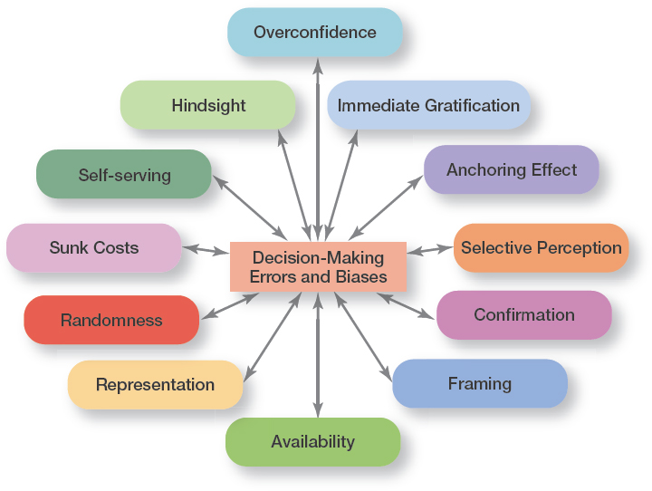
Exhibit 2-11: Common Decision-Making Biases
© Pearson Education Limited 2016

Slide 40
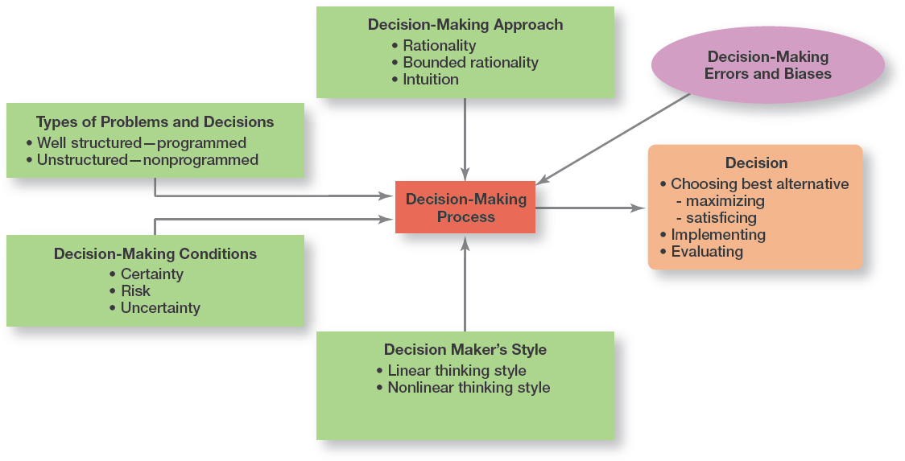
Exhibit 2-12: Overview of Managerial Decision-Making
© Pearson Education Limited 2016

Slide 41
Guidelines for Making Effective Decisions
Understand cultural differences
Create standards for good decision-making
Know when it’s time to call it quits
Use an effective decision-making process
Develop your ability to think clearly
© Pearson Education Limited 2016

Slide 42
An Effective Decision-making Process
It focuses on what’s important.
It’s logical and consistent.
It acknowledges both subjective and objective thinking and blends analytical with intuitive thinking.
It requires only as much information and analysis as is necessary to resolve a particular dilemma.
It encourages and guides the gathering of relevant information and informed opinion.
It’s straightforward, reliable, easy to use, and flexible.
© Pearson Education Limited 2016

Slide 43

Design Thinking and Decision Making
Design Thinking – Approaching management problems as designers approach design problems e.g. Hyundai test with safari park baboons!
© Pearson Education Limited 2016

Slide 44

Big Data and Decision Making
Big Data – the vast amount of quantifiable information that can be analyzed by highly sophisticated data processing
Big data can be characterized by the three V’s:
High volume
High velocity
High variety
© Pearson Education Limited 2016

Slide 45
Review Learning Objective 2.1
Describe the eight steps in the decision-making process.
Identify Problem
Identify Decision Criteria
Weight The Criteria
Develop Alternatives
Analyze Alternatives
Select Alternative
Implement Alternative
Evaluate Decision Effectiveness
© Pearson Education Limited 2016

Slide 46
Review Learning Objective 2.2
Explain the four ways managers make decisions.
Assumptions of rationality
The problem is clear and unambiguous
A single, well-defined goal is to be achieved
All alternatives and consequences are known
The final choice will maximize the payoff
© Pearson Education Limited 2016

Slide 47
Review Learning Objective 2.2
Satisficing – When decision makers accept solutions that are good enough.
Escalation of commitment – Managers increase commitment to a decision, even when they have evidence it may have been a wrong decision.
Intuitive decision – making means making decisions on the basis of experience, feelings, and accumulated judgment.
Evidence-based management – a manager makes decisions based on the best available evidence.
© Pearson Education Limited 2016

Slide 48
Review Learning Objective 2.3
Classify decisions and decision-making conditions.
Programmed decisions are repetitive decisions that can be handled by a routine approach and are used when the problem being resolved is straightforward, familiar, and easily defined (structured).
Nonprogrammed decisions are unique decisions that require a custom-made solution and are used when the problems are new or unusual (unstructured) and for which information is ambiguous or incomplete.
© Pearson Education Limited 2016

Slide 49
Review Learning Objective 2.3
Classify decisions and decision-making conditions.
Certainty is a situation in which a manager can make accurate decisions because all outcomes are known.
Risk is a situation in which a manager can estimate the likelihood of certain outcomes.
Uncertainty is a situation in which a manager is not certain about the outcomes and can’t even make reasonable probability estimates.
© Pearson Education Limited 2016

Slide 50
Review Learning Objective 2.4
Describe different decision-making styles and discuss how biases affect decision-making.
Linear thinking style – Characterized by a person’s preference for using external data and processing this information through rational, logical thinking.
Nonlinear thinking style – Characterized by a preference for internal sources of information and processing this information with internal insights, feelings, and hunches.
© Pearson Education Limited 2016

Slide 51
Review Learning Objective 2.4
Describe different decision-making styles and discuss how biases affect decision-making.
The 12 common decision-making errors and biases include overconfidence, immediate gratification, anchoring, selective perception, confirmation, framing, availability, representation, randomness, sunk costs, self-serving bias, and hindsight.
© Pearson Education Limited 2016

Slide 52
Review Learning Objective 2.5
Identify effective decision-making techniques.
An effective decision-making process
Focuses on what’s important
Is logical and consistent
Acknowledges both subjective and objective thinking and blends both analytical and intuitive approaches
Requires only “enough” information as is necessary to resolve a problem
Encourages and guides gathering relevant information and informed opinions
Is straightforward, reliable, easy to use, and flexible
© Pearson Education Limited 2016

Slide 53
Review Learning Objective 2.5
Identify effective decision-making techniques.
Design thinking is “approaching management problems as designers approach design problems.” It can be useful when identifying problems and when identifying and evaluating alternatives. Using big data, decision makers have power tools to help them make decisions. However, no matter how comprehensive or well analyzed the big data, it needs to be tempered by good judgment.
© Pearson Education Limited 2016

